Slide 1

Retrieval-Augmented Generation (RAG)
RAG (Retrieval-Augmented Generation) is a technique where a language model retrieves relevant external information and uses it to generate more accurate, context-aware responses.
Challenges with LLM-only approach:
Cannot access internal or private PDF documents
Limited context window for large documents
Higher risk of hallucinated answers
What RAG Solves:
Connects LLMs with enterprise knowledge
Retrieves relevant content before answering
Produces grounded and accurate responses

Slide 2
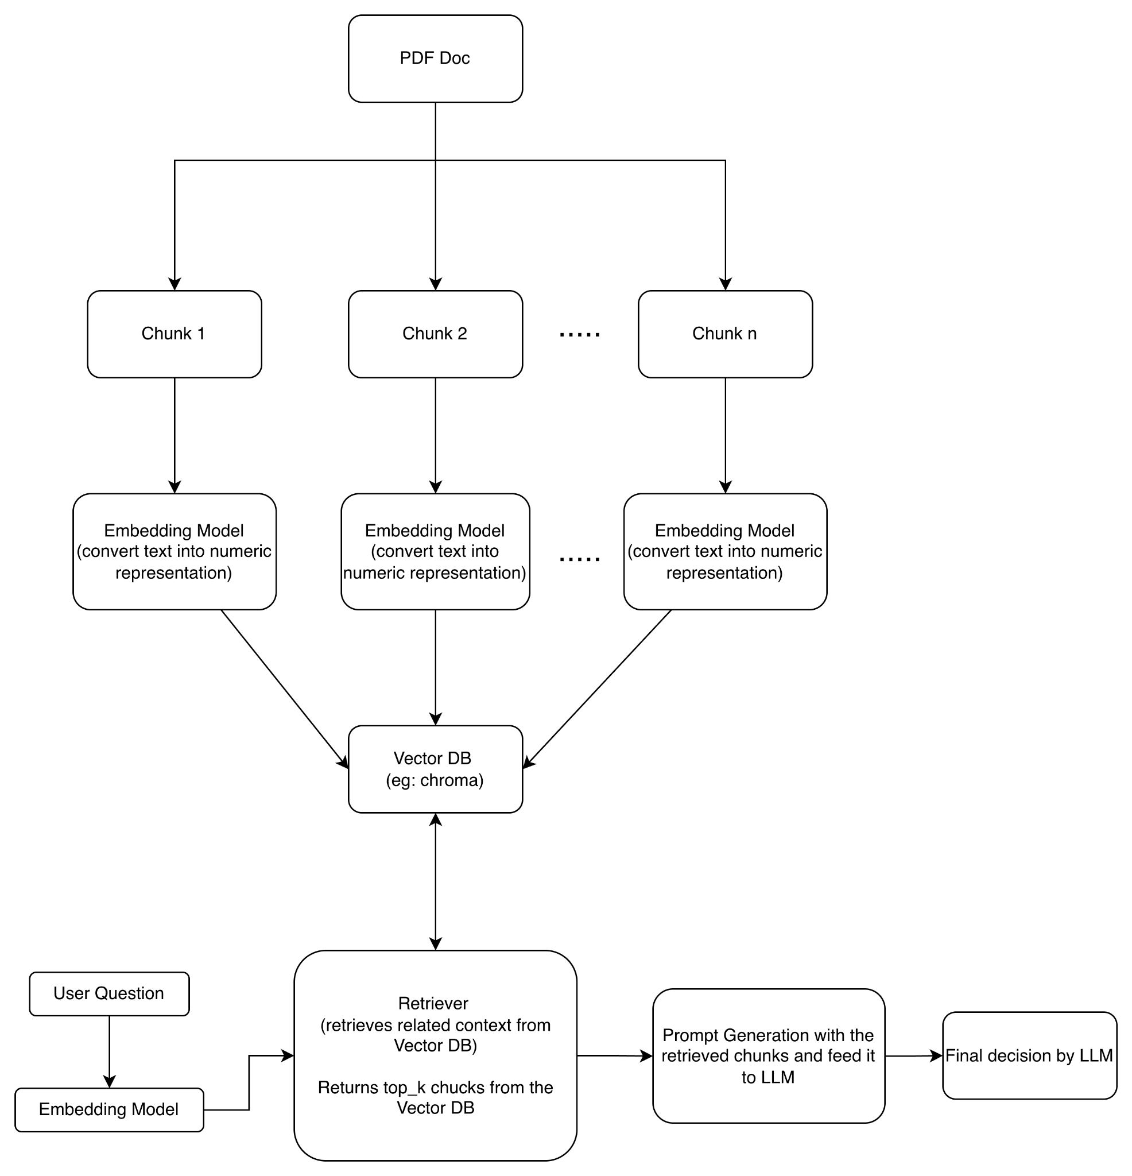
RAG - Workflow Diagram
Working of LLM with RAG:
Documents are processed and indexed
User question triggers semantic search
Relevant context is retrieved
LLM generates an answer using that context

Slide 3
Document Ingestion & Indexing
PDF → Chunks → Embeddings → Vector DB
PDF files are read and text is extracted
Large documents are broken into small text pieces
Smaller chunks are easier for models to process
Each text chunk is converted into a numeric format
Data is stored in a vector database for fast search

Slide 4
Query Handling & Retrieval
User → Query embedding → Vector DB → Top-K chunks
User submits a natural language question
Question is converted into an embedding
Similarity search performed on vector database
Top-K relevant chunks are selected
Only relevant information is retrieved

Slide 5
LLMs Final Desicion
Retrieved Context + User Question → LLM → Answer
Retrieved chunks are injected into the prompt
LLM is instructed to answer using provided context
Final response is Generated

